Slide 1
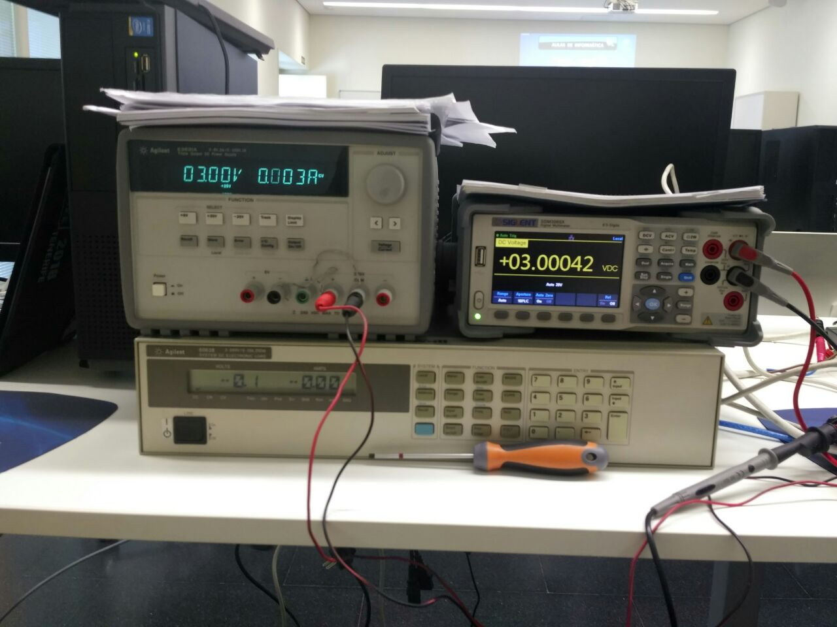
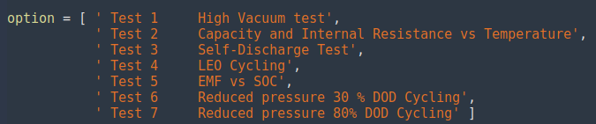
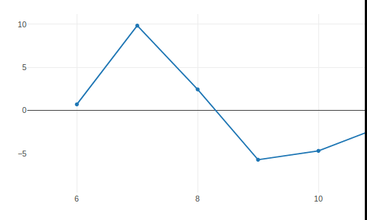


Description and objectives
1 Create an interface to choose the test
2 Obtain medition data
Turn on machine, charge, discharge, control temperature...
-current
- Voltage
- Capacity
3 View in real time
4 Save the results
Save result in csv format.
comma-separated values
Three simultaneous graphs

Slide 2
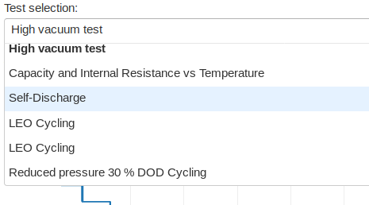
Week development
Monday
Tabs type
Problems:
Beta building library
Constraint design
Design interface
Dropdown
type
Final option
Tuesday
Wednesday
Solve libraries incompatibilities causes by
python virtual enviroment.
Start random value graph update
Finished random value graph.
Started imports unification, until that we had development, independently to reduce posibles error.
Interface
Main
Battery
tester
Tests call
(random
dimulation)
Thursday
Continued unification process
Data save
As an import

Slide 3
Actual state: direct taste
Steps
1. Open console
2. Execute main
3. Open web browser, with given direction
Requeriments
pip install dash==0.21.1 # The core dash backend
pip install dash-renderer==0.13.0 # The dash front-end
pip install dash-html-components==0.11.0 # HTML components
pip install dash-core-components==0.23.0 # Supercharged components
pip install plotly --upgrade # Plotly graphing library used in examples
pip install pandas # pandas
pip install renderer
pip install render

